Slide 1
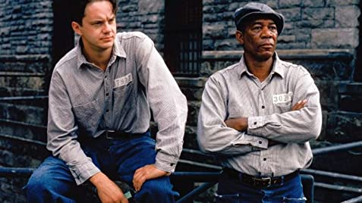






IMDb Analysis
Proposal
Bruno Vaz, Fátima Barros, Maria João Lavoura
Professor: Álvaro Figueira
16 November 2020

Slide 2

IMDb Datasets
Internet Movie Database
People rely on other’s ratings for choosing their next movie or show
Information on:
- Titles
- Cast and crew
- Ratings and number of votes
- Gender
- …

Slide 3
Filtering
Title Basics
short
movie
tvMovie
tvSeries
tvShort
tvMiniSeries
tvEpisode
tvSpecial
Video
videoGame
7 281 233

Slide 4

Filtering
Title Basics
short
movie
tvMovie
tvSeries
tvShort
tvMiniSeries
tvEpisode
tvSpecial
Video
videoGame
Title Basics
1 443 759
7 281 233

Slide 5
Filtering
Title Basics
short
movie
tvMovie
tvSeries
tvShort
tvMiniSeries
tvEpisode
tvSpecial
Video
videoGame
Title Basics
1 443 759
Filtering by tconst…
7 281 233
Title Akas
Title Ratings
Title Crew
Title Principals
Name Basics
Filtering by nconst…

Slide 6
Cleaning
Title Basics
Title Principals
Title Crew
1 443 759
↓11%
4 621 598
=
2 211 001
↓8%
1 277 962
4 621 598
1 911 339
Title Akas
Title Ratings
Name Basics
2 211 001
↓14%
423 183
=
1 634 635
↓6%
1 911 339
423 183
1 532 134

Slide 7
Cleaning
Title Basics
Title Principals
Title Crew
MERGE
1 443 759
↓11%
4 621 598
=
2 211 001
↓8%
1 277 962
4 621 598
1 911 339
Title Akas
Title Ratings
Name Basics
2 211 001
↓14%
423 183
=
1 634 635
↓6%
1 911 339
423 183
1 532 134

Slide 8
Hypotheses
Titles per Region
Titles’ Success
Audience Success
Titles Awards

Slide 9
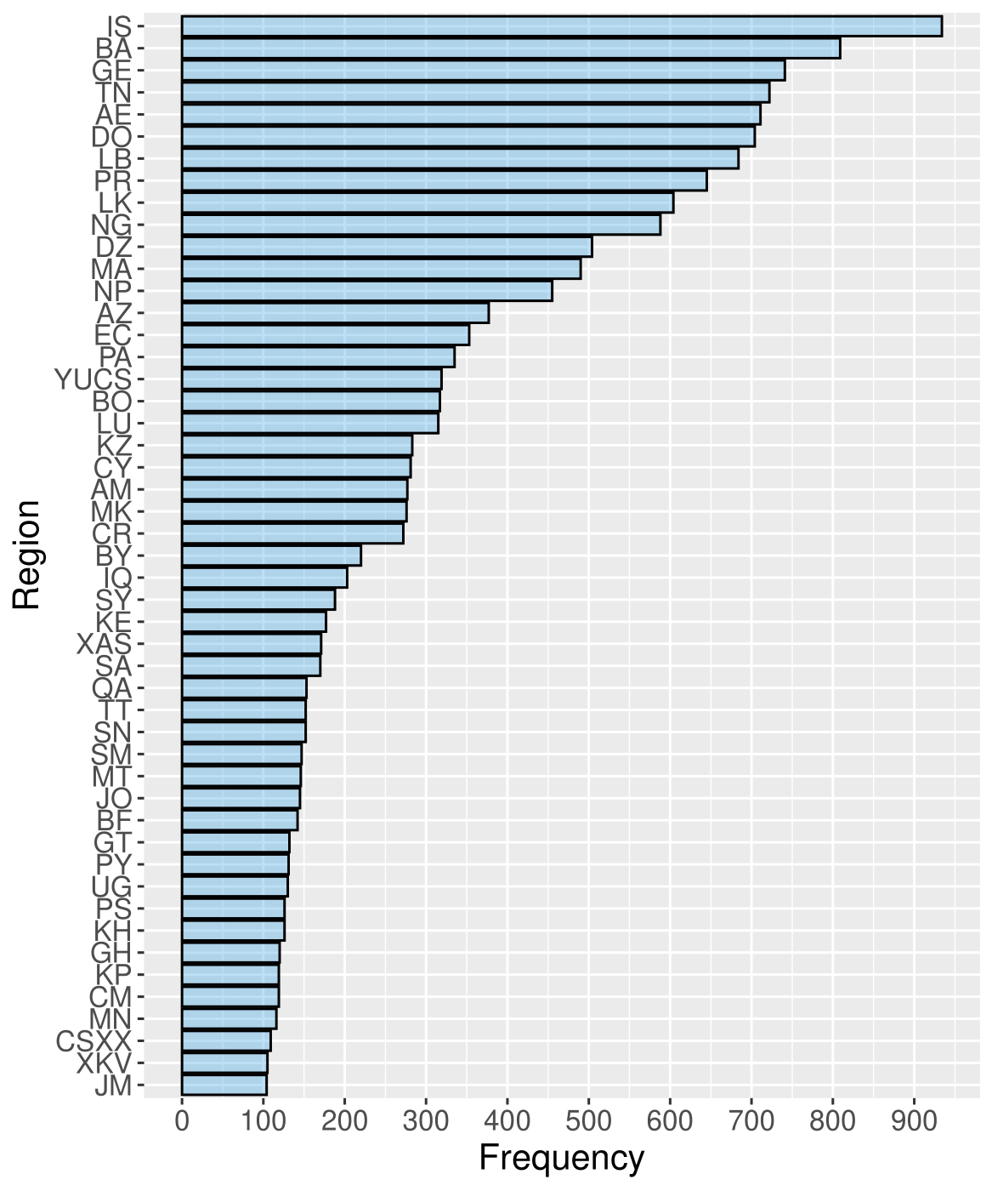
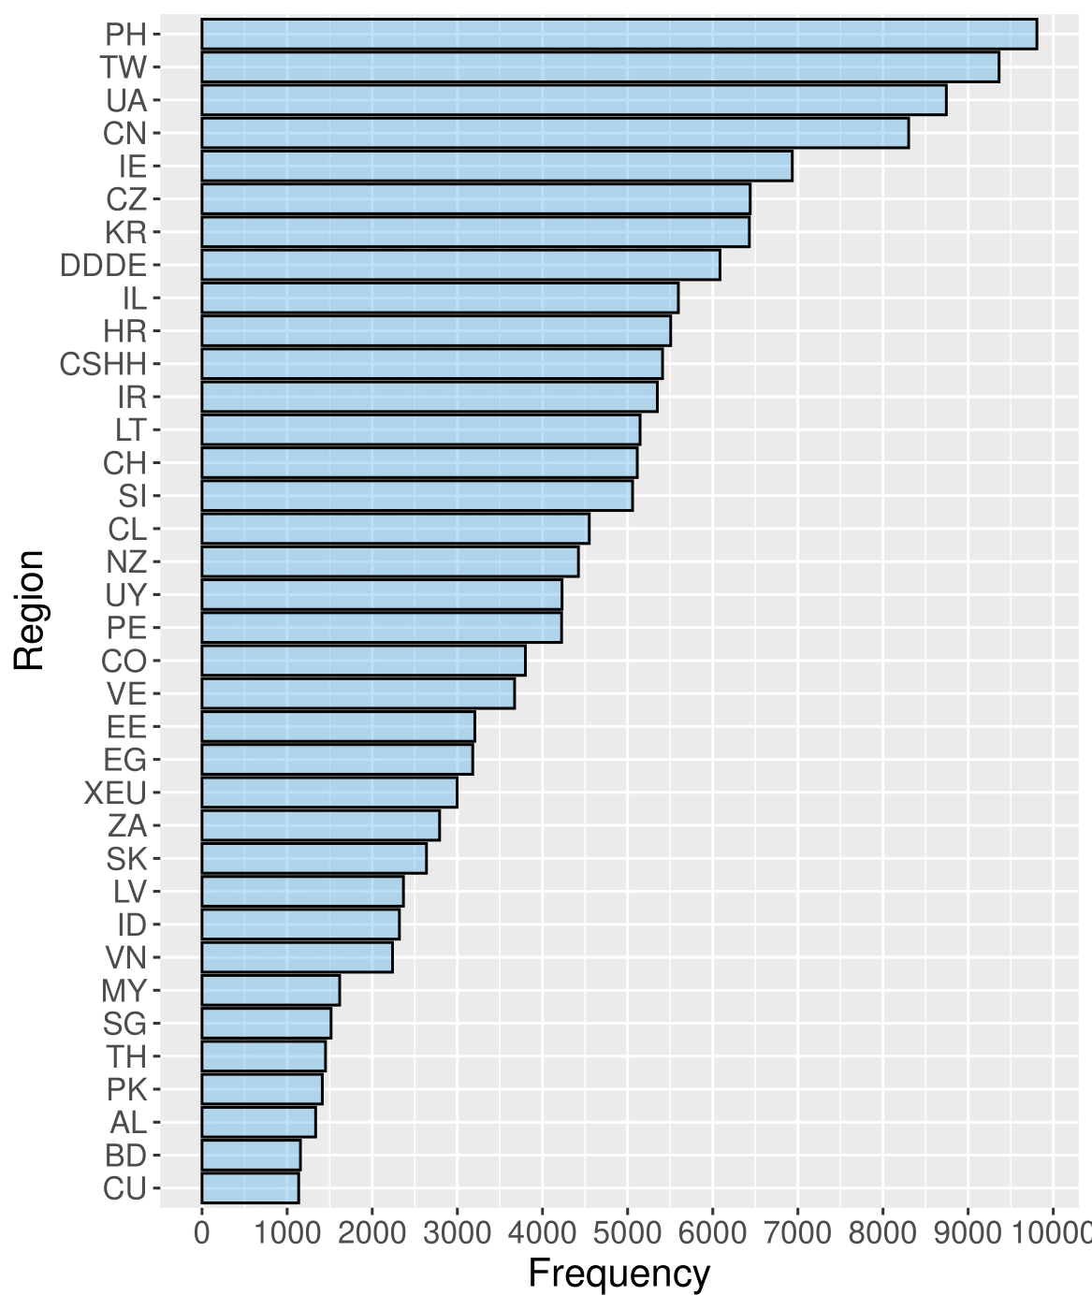
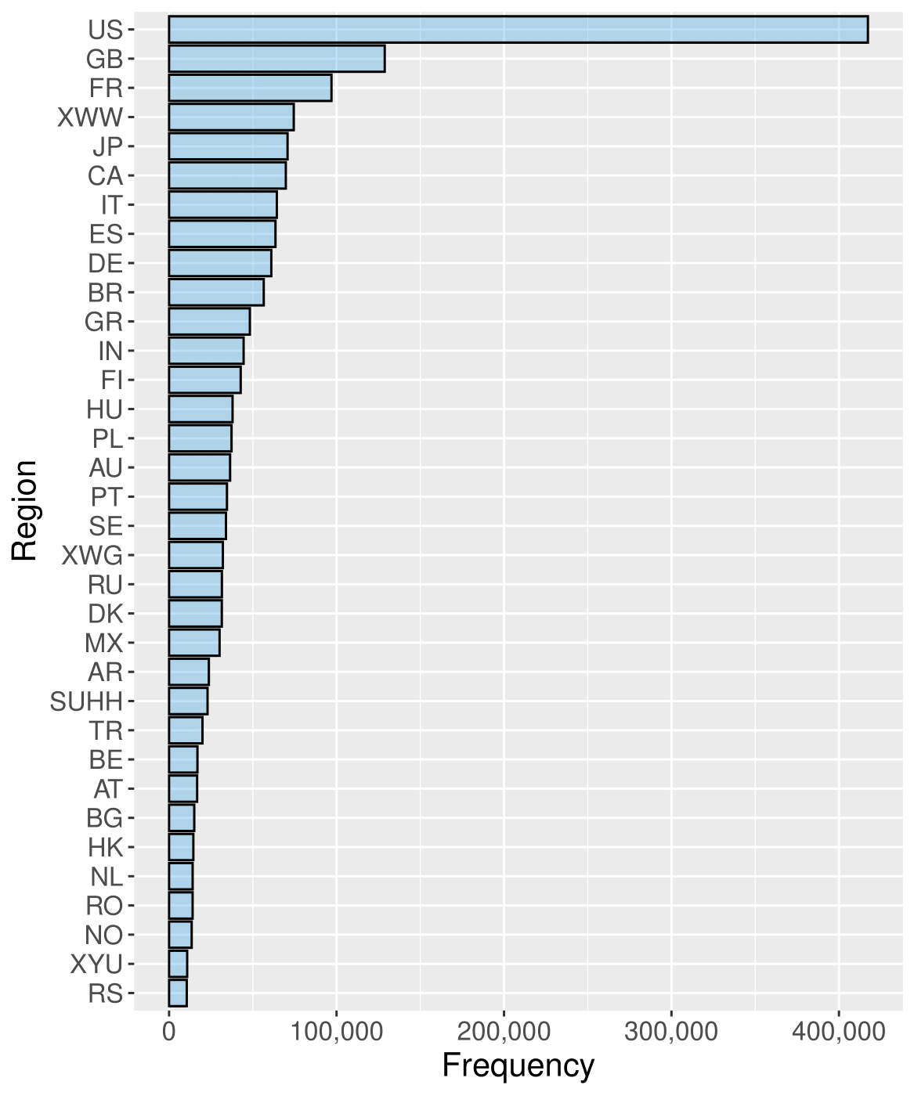
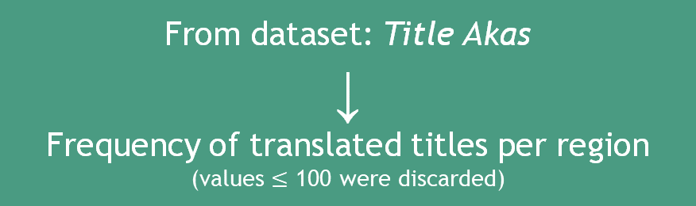
Titles per Region
From dataset: Title Akas
↓
Frequency of translated titles per region
(values $≤$ 100 were discarded)

Slide 10
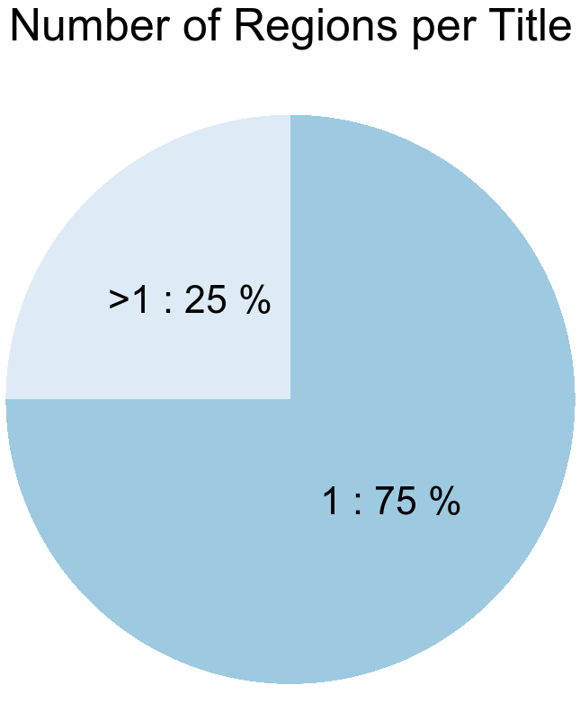
Titles per Region
From dataset: Title Akas
↓
Counts or regions per title

Slide 11
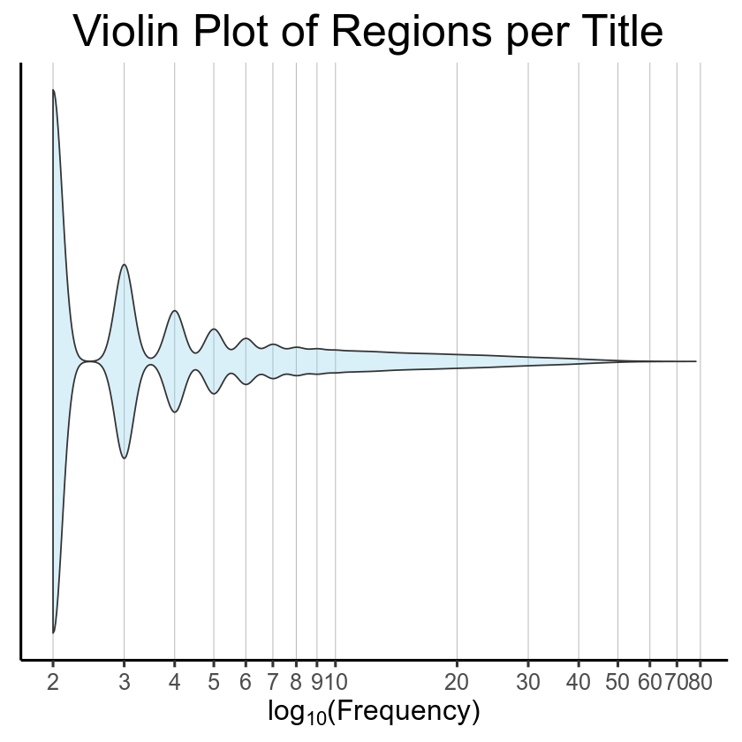
Titles per Region
From dataset: Title Akas
↓
Counts or regions per title

Slide 12
Titles per Region
HYPOTHESIS
“Is the title’s success (rating and number of votes) higher when it is translated to other languages?”

Slide 13
Hypotheses
Titles per Region
Titles’ Success
Audience Success
Titles Awards

Slide 14

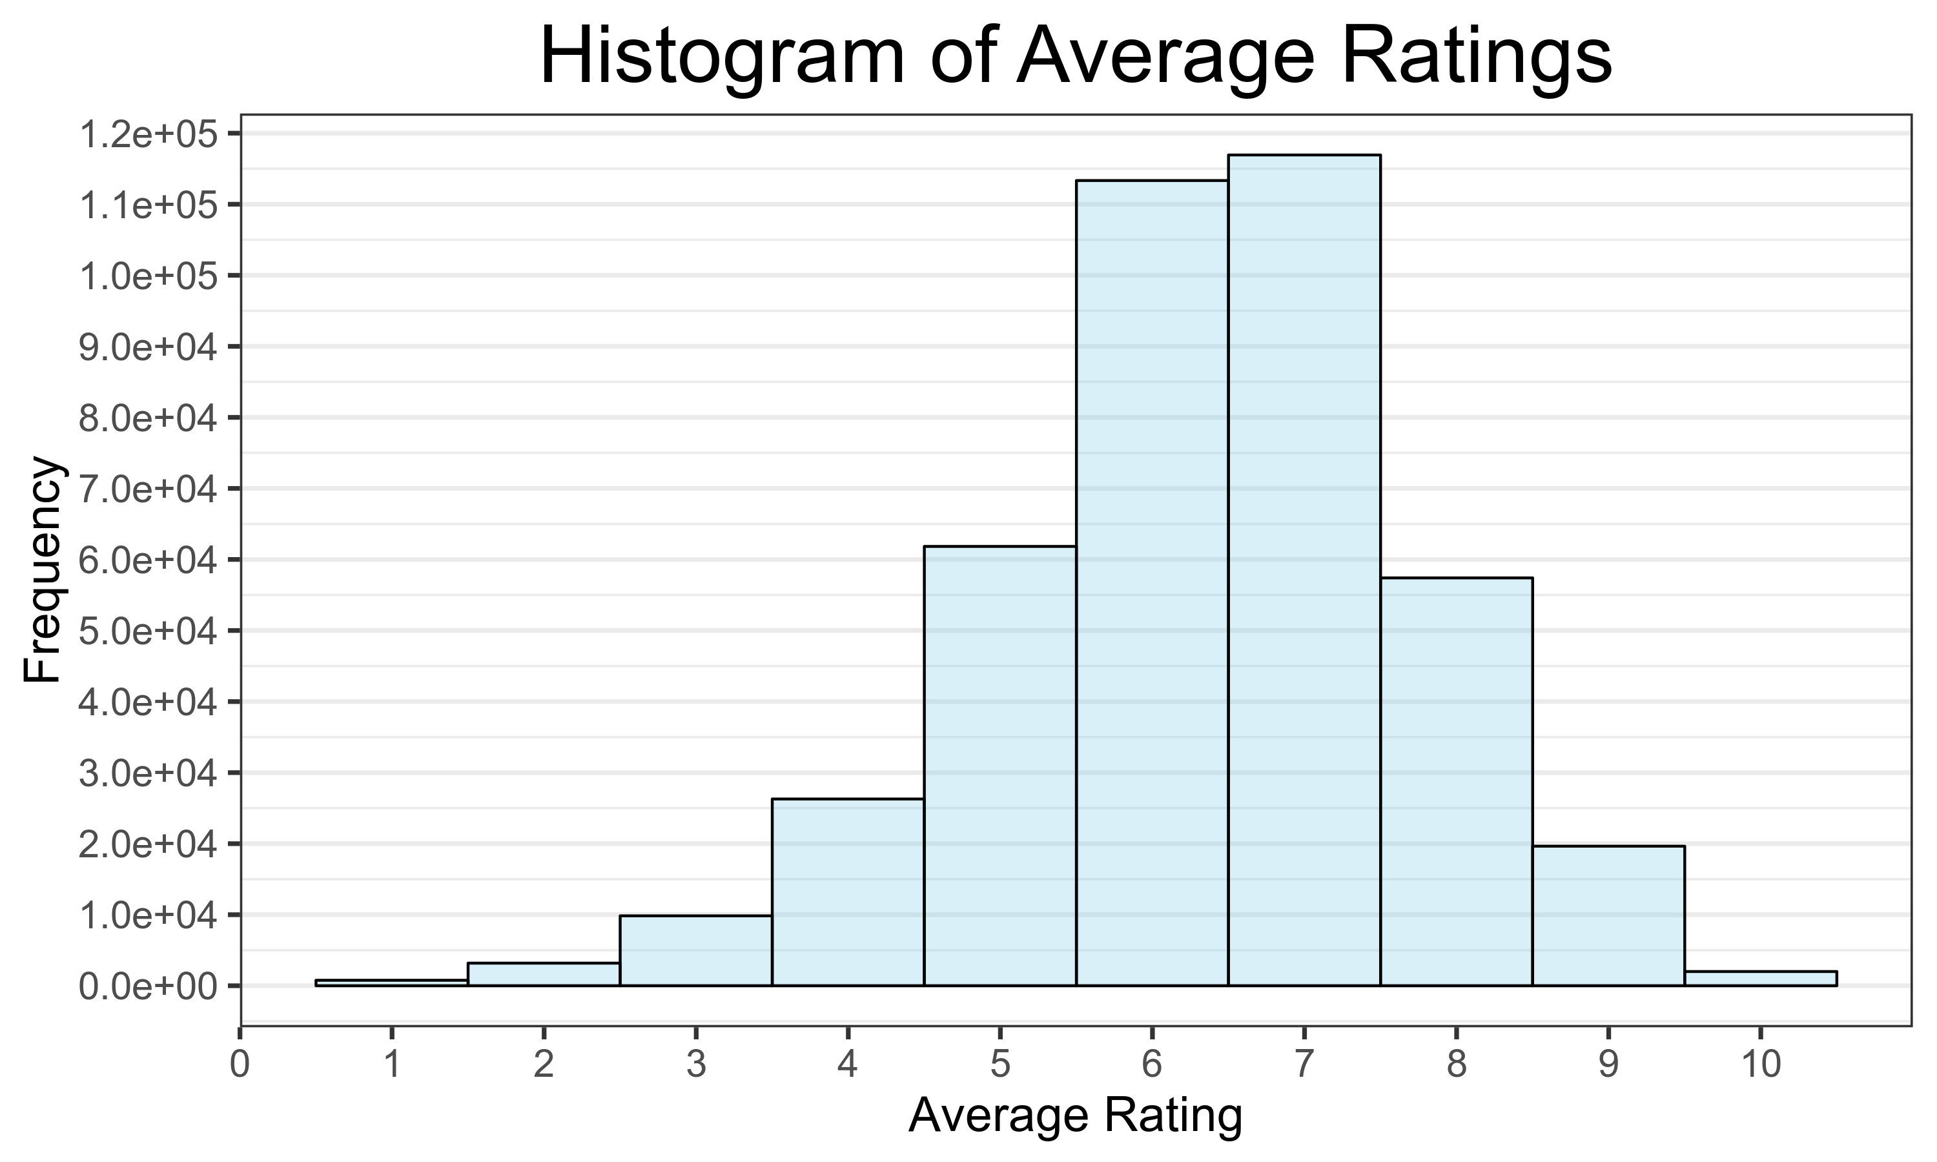
Titles’ Success
Audience Success
PRODUCTION
SCENE
ROLL
TAKE
DIRECTOR
CAMERA
DATE
PROD.CO.
From dataset: Title Ratings
↓
Average Rating Histogram

Slide 15
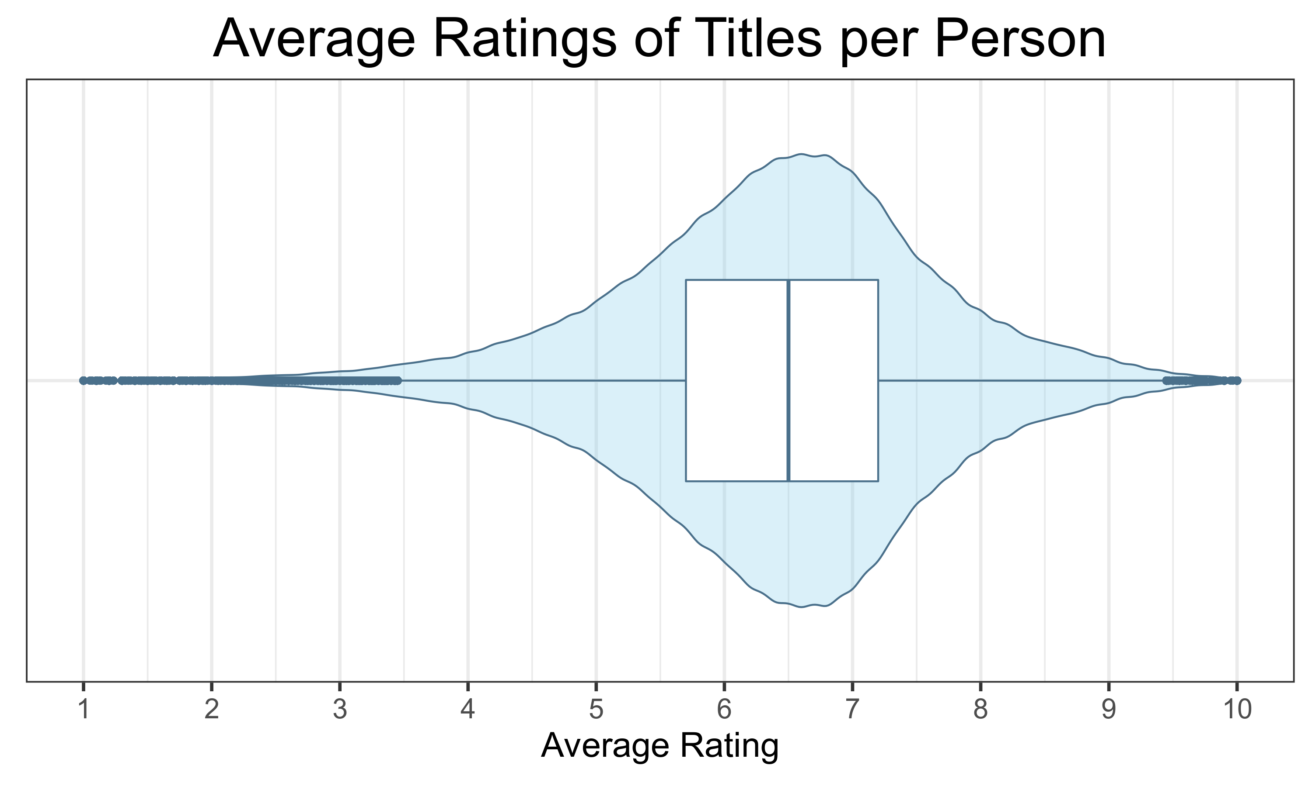
Titles’ Success
Audience Success
PRODUCTION
SCENE
ROLL
TAKE
DIRECTOR
CAMERA
DATE
PROD.CO.
From dataset: Title Ratings & Name Basics
↓
Violin & Box Plot

Slide 16
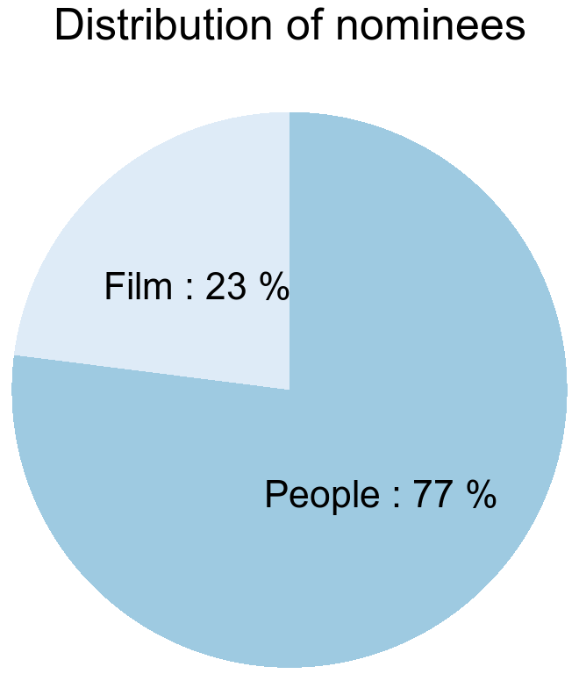
Titles’ Success
External dataset: Golden Globes, 1944-2019
↓
Pie Chart – Nominees of different awards
916 correspondences with Title Basics
Title Awards
PRODUCTION
SCENE
ROLL
TAKE
DIRECTOR
CAMERA
DATE
PROD.CO.
External dataset: Emmy Awards, 1949-2019
1911 correspondences with Title Basics

Slide 17
Titles’ Success
Title Awards
PRODUCTION
SCENE
ROLL
TAKE
DIRECTOR
HYPOTHESIS
CAMERA
DATE
PROD.CO.
“Does the cast/crew of a movie makes it successful?”

Slide 18







Any questions?

